Slide 1
A Guide to Choosing What’s Right for Your Kitchen
OILS

Slide 2
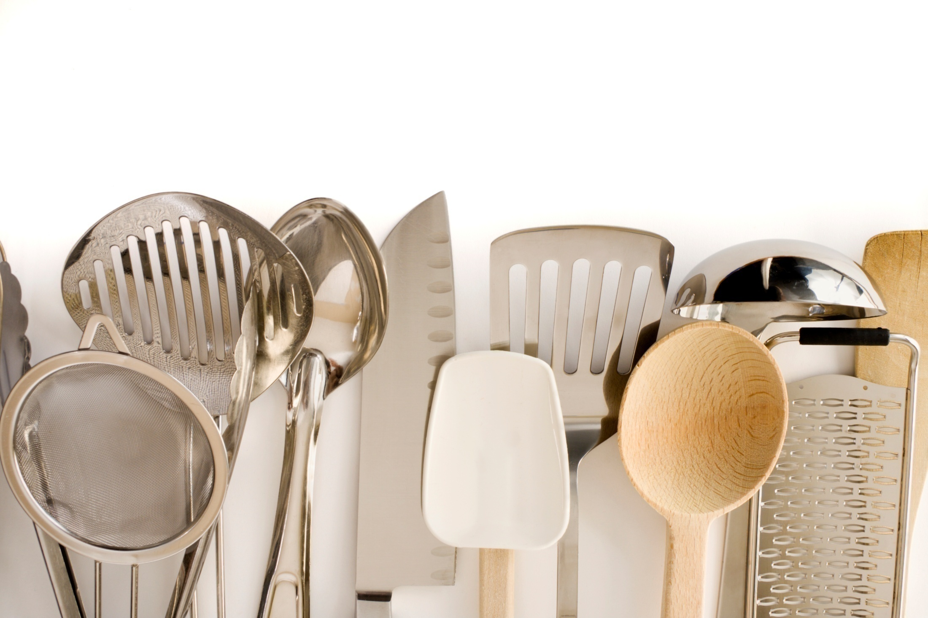
Course Objectives
Provide basic information on how to purchase and handle cooking oils
Guide you in selecting cooking oils for optimum performance, health benefit, taste and application

Slide 3
Increasing Consumer Awareness
Question:
In a 2008 National Restaurant Association survey, what percent of adults indicated they were trying to eat healthier when going out to restaurants?
A. 52%
B. 63%
C. 76%

Slide 4
Increasing Consumer Awareness
Question:
In a 2008 National Restaurant Association survey, what percent of adults indicated they were trying to eat healthier when going out to restaurants?
A. 52%
B. 63%
C. 76%

Slide 5
Increasing Consumer Awareness
Question:
In the 2008 National Restaurant Survey, what percentage of adults searched restaurant nutrition information on the Internet prior to eating out?
A. 13%
B. 25%
C. 41%

Slide 6
Increasing Consumer Awareness
Question:
In the 2008 National Restaurant Survey, what percentage of adults searched restaurant nutrition information on the Internet prior to eating out?
A. 13%
B. 25%
C. 41%

Slide 7
Increasing Consumer Awareness
Question:
What percentage of consumers were aware of
trans fats and associated health risks in 2008?
A. 34%
B. 69%
C. 92%

Slide 8
Increasing Consumer Awareness
Question:
What percentage of consumers were aware of
trans fats and associated health risks in 2008?
A. 34%
B. 69%
C. 92%

Slide 9
Increasing Consumer Awareness
Question:
Of those consumers who were aware of specific fats and oils, what percentage were aware that animal fats increase the risk of heart disease?
A. 54%
B. 71%
C. 76%

Slide 10
Increasing Consumer Awareness
Question:
Of those consumers who were aware of specific fats and oils, what percentage were aware that animal fats increase the risk of heart disease?
A. 54%
B. 71%
C. 76%

Slide 11
Increasing Consumer Awareness
True or False:
5% of consumers say they sometimes or always ask their servers about the types of oil or fat used to prepare foods on the menu.
True
False

Slide 12
Increasing Consumer Awareness
True or False:
5% of consumers say they sometimes or always ask their servers about the types of oil or fat used to prepare foods on the menu.
True
False

Slide 13
Increasing Consumer Awareness
True or False:
50% of consumers consider the “healthfulness”
of restaurant food based on amount of fat.
True
False

Slide 14
Increasing Consumer Awareness
True or False:
50% of consumers consider the “healthfulness”
of restaurant food based on amount of fat.
True
False

Slide 15
Increasing Consumer Awareness
True or False:
45% of participants in a 2007 study indicated they
were concerned about both the types and amounts
of fat they consume.
True
False

Slide 16
Increasing Consumer Awareness
True or False:
45% of participants in a 2007 study indicated they
were concerned about both the types and amounts
of fat they consume.
True
False

Slide 17
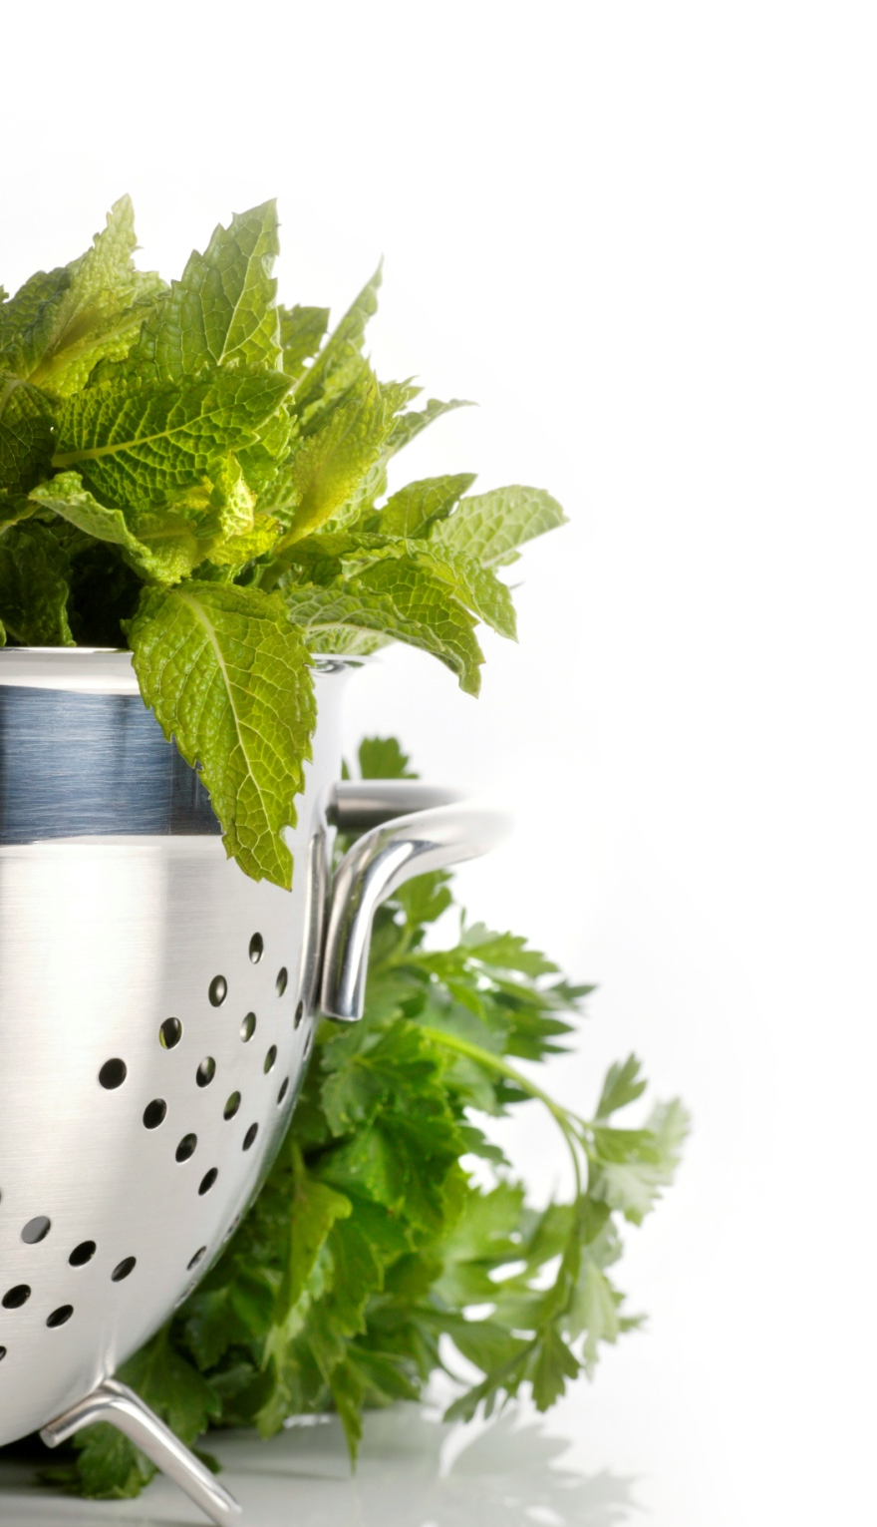
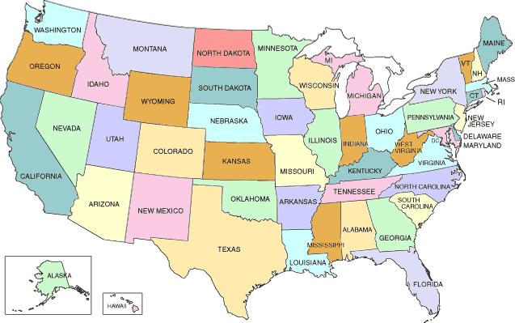
Passed and Pending Legislation on Oil Use in Food Service
Local ban
State ban
Notes:
Trans Fat Banned in Fried Foods
Albany County, NY (2009)
Baltimore, MD (2009)
Boston, MA (2008)
Brookline, MA (2008)
Montgomery County, MD (2008)
Stamford, CT (2008)
Westchester County, NY (2008)
King County, WA (2008)
New York City, NY (2007)

Slide 18
Chains Voluntarily Transitioning
Notes:
77% of top 100 casual dining and quick service restaurant chains are in some phase of transition to non-trans fat frying oils
57% of those chains have fully transitioned to trans fat free oil usage
Of the chains that have transitioned or are transitioning, 49% use soybean oil and 34% use canola oil
**Note that California goes into effect Jan. 1, 2010.

Slide 19
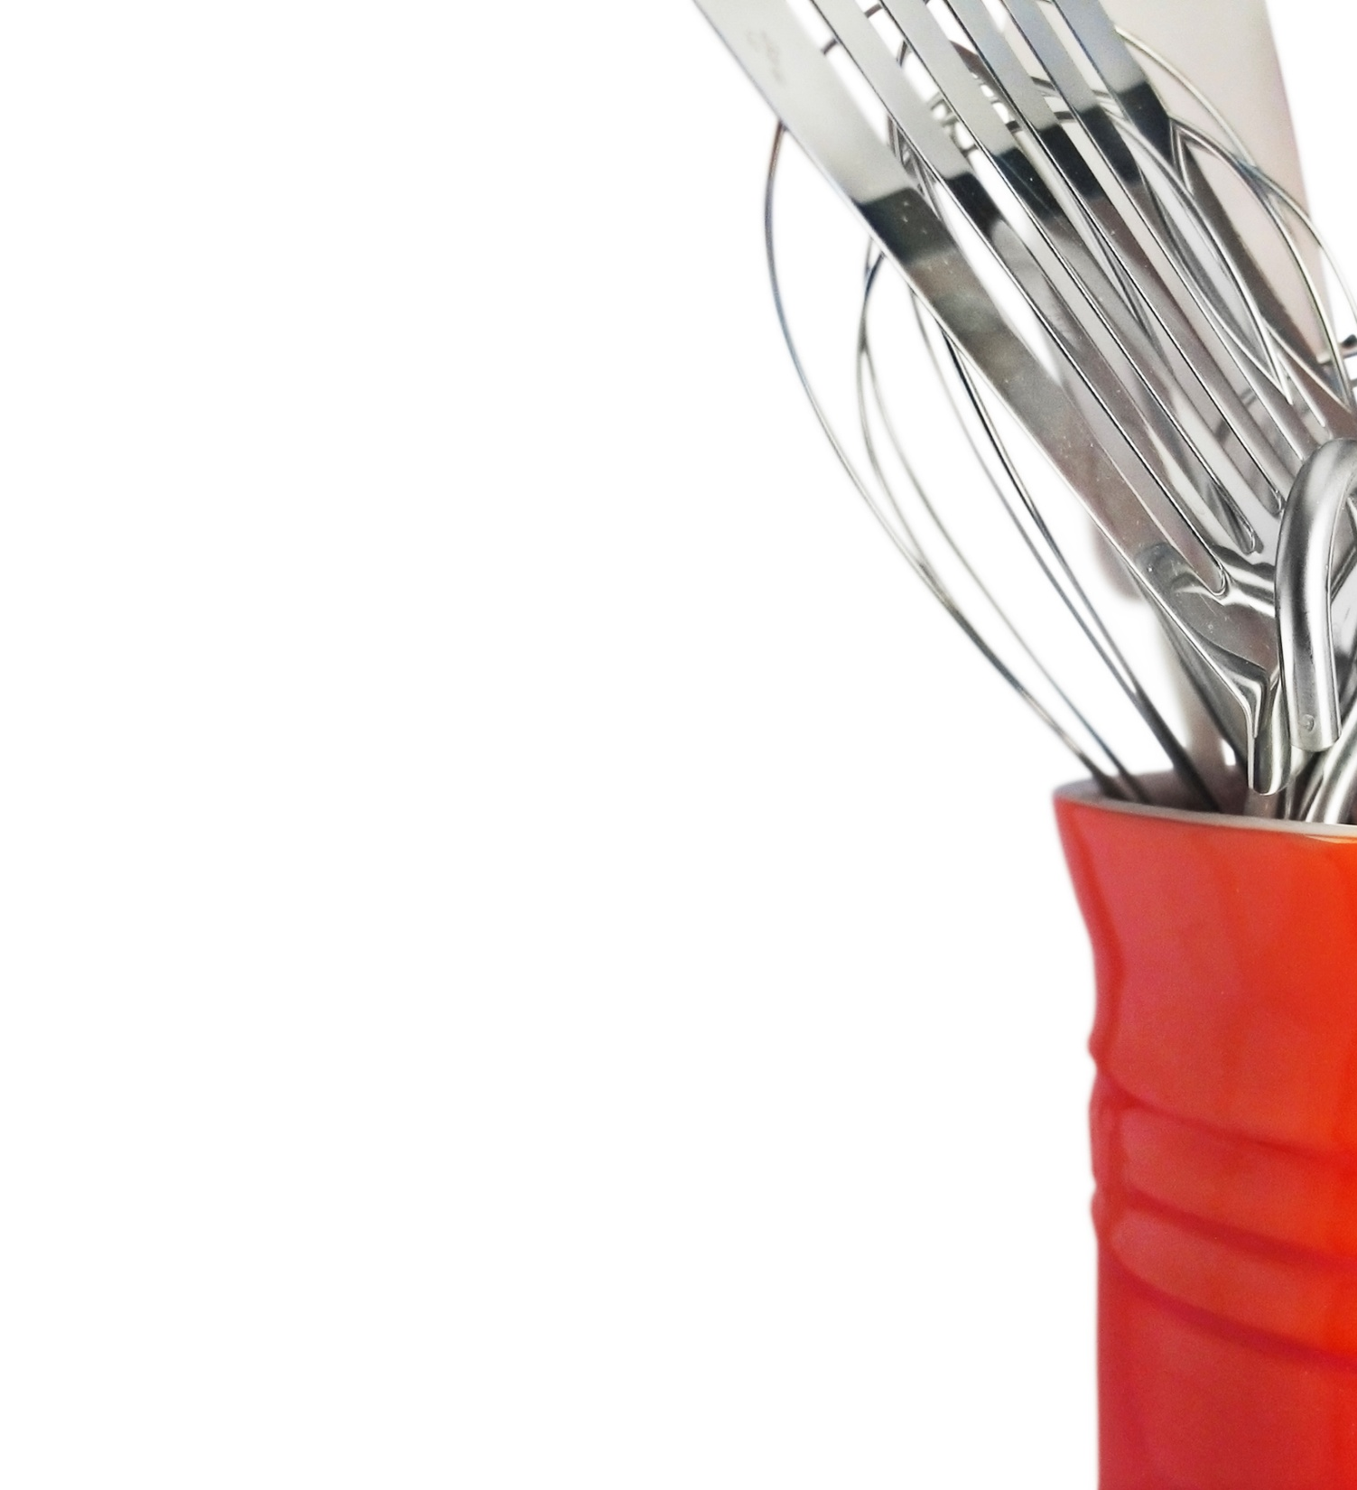
Oil Sources
Type of Oil
Canola oil
Corn oil
Cottonseed oil
Olive oil
Palm oil
Peanut oil
Soybean oil
Sunflower oil
Source
Canola plant (seed)
Germ of corn (seed)
Cotton plant (seed)
Olive tree (fruit)
Palm plant (fruit and seed)
Peanut plant (fruit)
Soybean plant (bean)
Sunflower plant (seed)

Slide 20
Trans fat
Byproduct of the hydrogenation process that increases vegetable oil stability and shelf life
Turns liquid oils into a form that is solid at room temperature
Easy to produce, lasts a long time, imparts some taste and texture, and can be used many times in fryers
Raises the level of LDL (commonly referred to as “bad” cholesterol) while lowering the level of HDL (known as “good” cholesterol)
One study estimates that between 30,000 and 100,000 cardiac deaths occur per year in the United States due to consumption of trans fats

Slide 21
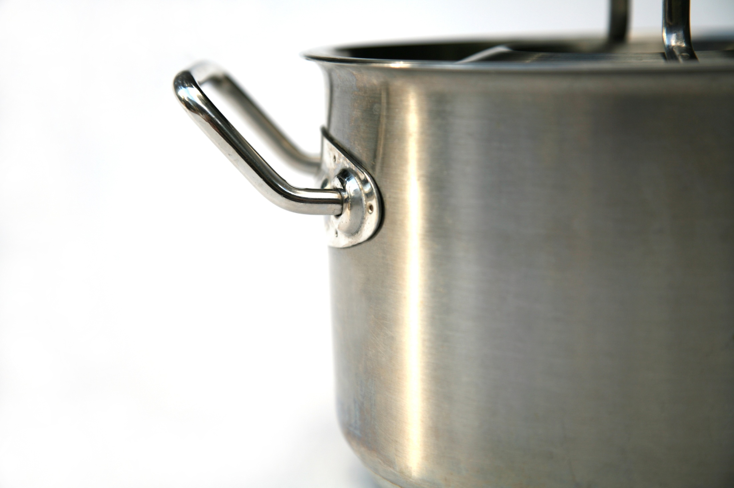
Saturated Fat
Occurs naturally in foods derived from animals, such as meat and dairy products
Some plant foods, such as palm oil and coconut oil also contain saturated fats
Considered a main dietary factor contributing to risk of cardiovascular disease, stroke and cancer
Does not lower HDL (known as the “good” cholesterol); but it does raise the level of LDL (or “bad” cholesterol)

Slide 22
Polyunsaturated Fats
Omega-3 and omega-6 fatty acids are essential fats, but can’t be produced by the human body
Omega-3s are obtained from fish and nuts
Omega-6s are found in meat, poultry and eggs
Both fatty acids are also contained in plant-based oils, such as canola or sunflower
Healthy diets should include 2-4 times more omega-6 fatty acids than omega-3 fatty acids
Typical North American diet may contain 11-30 times more omega-6 fatty acids

Slide 23
Monounsaturated Fat
Also known as oleic acids or Omega-9 fatty acids
Found in canola, sunflower, olive and nut oils
Helps reduce risk of cardiovascular disease and stroke
Increases HDL (“good”) cholesterol and decreases LDL (“bad”) cholesterol
Helps eliminate plaque buildup in arteries

Slide 24
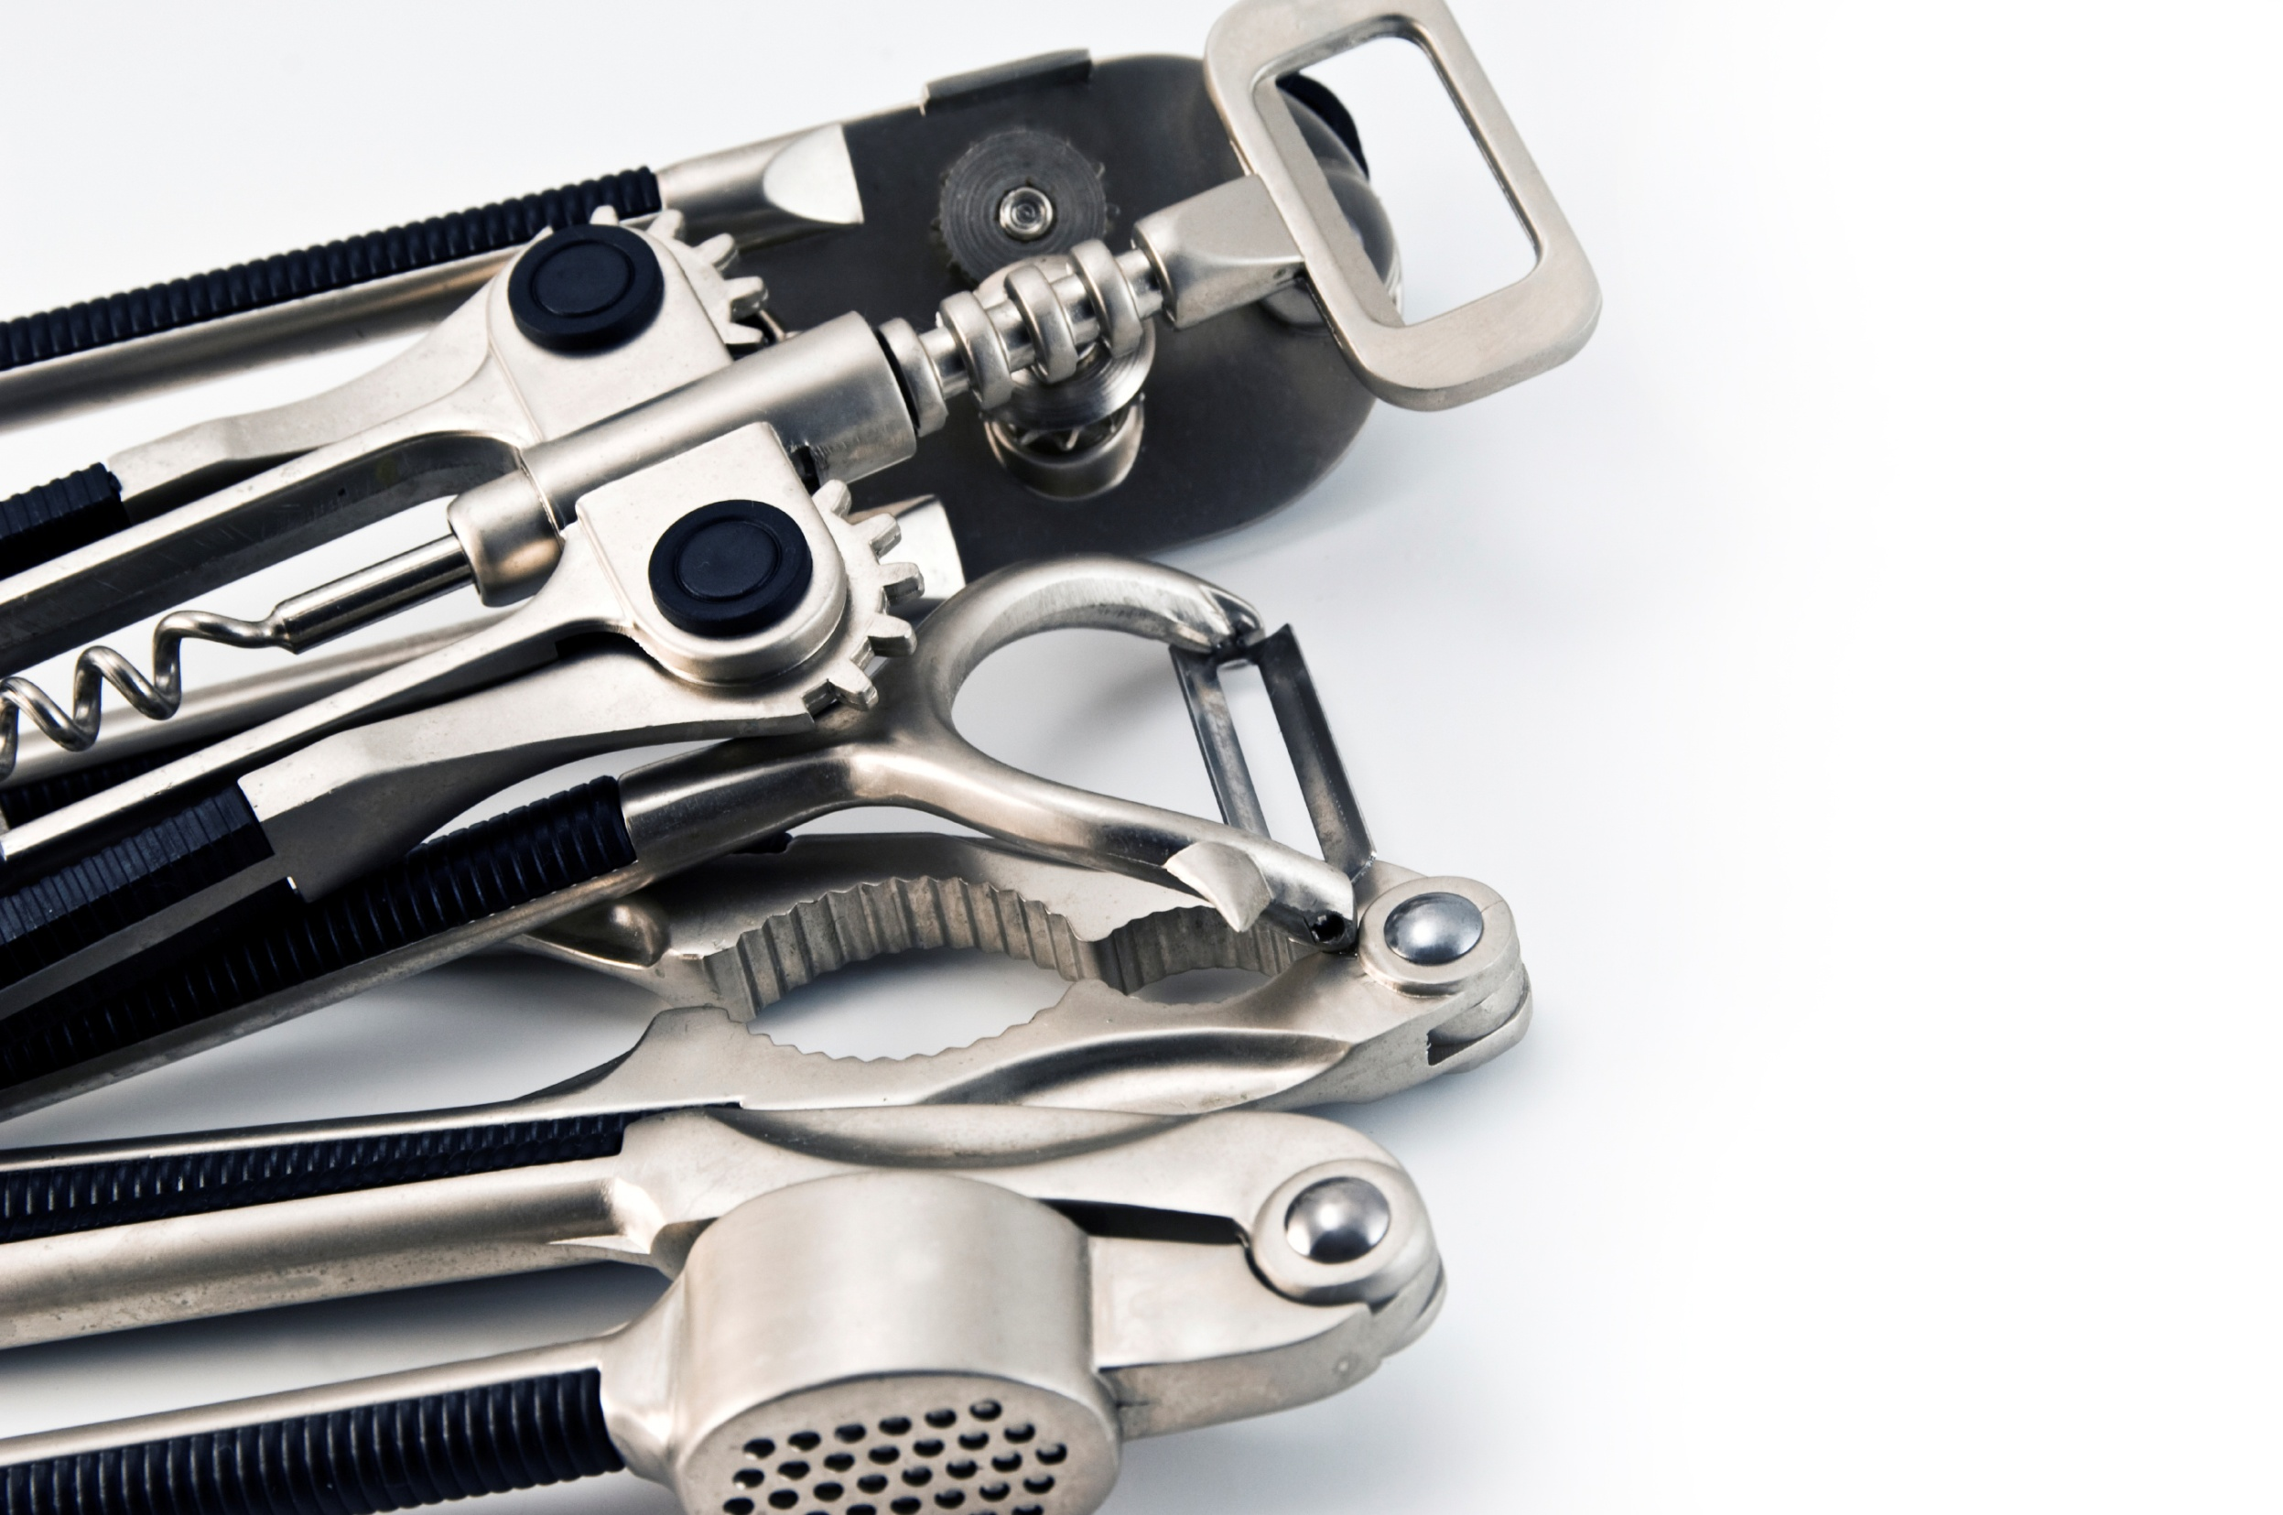
General Facts About Fats
All oils contain fats
Each tablespoon of oil has 14 grams of fat
All fats have same number of calories per gram
ADA — adults need 20% to 35% of their energy to come from dietary fats
ADA recommends using canola oil in food preparation to increase compliance with dietary recommendations
In 2006, FDA issued a qualified health claim on the ability of canola oil to reduce the risk of heart disease

Slide 25
Oils Comparison Health Snapshot
Cooking Oils | Health [% fat]
 | Mono | Trans | Sat | Poly
Canola | 61 | 0 | 7 | 32
Omega-9 Canola | 72 | 0 | 7 | 20
Olive | 75 | 0 | 15 | 10
Peanut | 48 | 1 | 19 | 32
Ph Soy | 42 | 16 | 18 | 26
Omega-9 Sunflower | 86 | 0 | 8 | 5

Slide 26
Consumer Taste Test
Both adults and teenagers preferred French fries prepared in Omega-9 Canola oil to fries prepared in partially-hydrogenated soybean oil typically used in restaurants

Slide 27
Definitions
Smoke point — temperature at which the oil begins to smoke and break down
Fry life — period of time oil may be used for frying before it needs to be changed
Shelf life — length of time oil may be stored without spoiling
Cost/value calculation — formula to determine the real cost of using one type of oil versus another based on multiple criteria

Slide 28
Oil Selection
Common Factors Used in Restaurants:
Application
Health characteristics
Cost
Taste

Slide 29
Cost of Oil
Factors that weigh into oil cost:
Actual dollar cost
Shelf life
Fry life
Versatility

Slide 30
Oil Use and Maintenance

Slide 31
Benefits of Frequent Filtering
Removes food particles and impurities
Makes cleaning the fryer easier
Improves fried food appearance and taste
Maintains oil color and clarity
Reduces build-up in the fryer
Extends the life of the oil

Slide 32
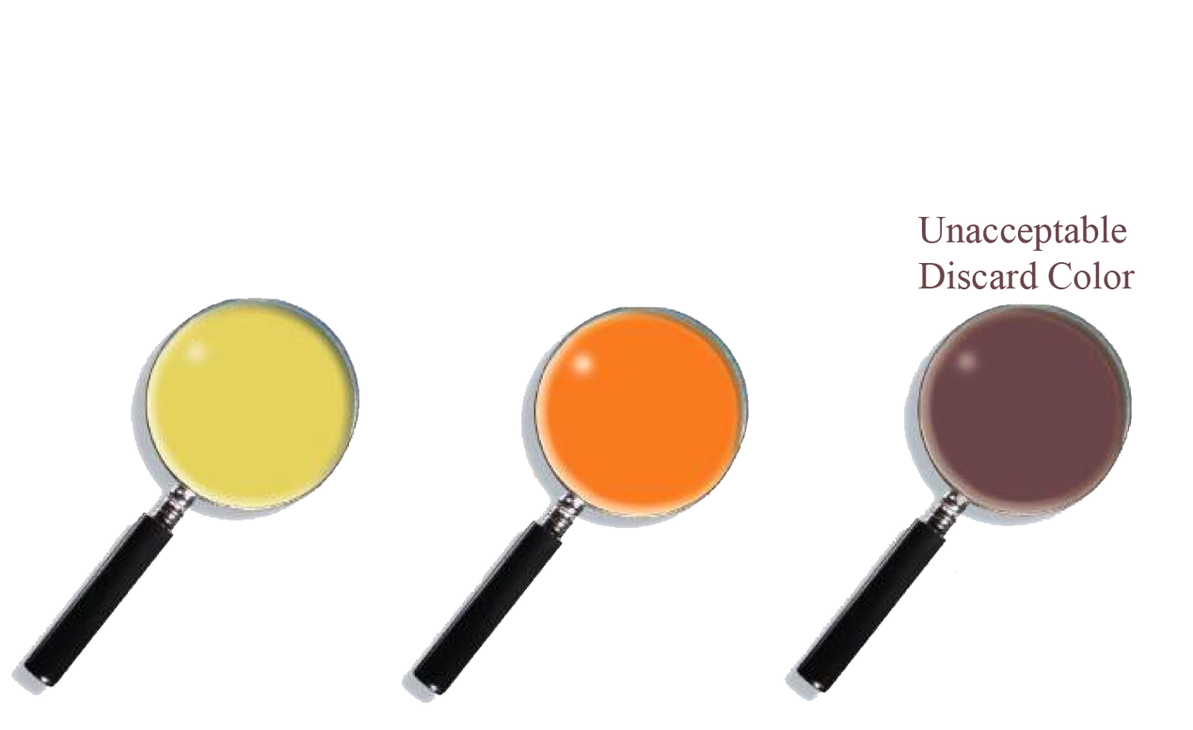
Oil Color
Dip the oil tester carefully into each fryer to get a sample of the oil. (Oil can be tested hot or cold.)
Hold the oil tester against this chart, in the outline below.
If the oil color is as dark as “Unacceptable Discard Color,” check food color and get Shift Leader or above approval to discard the oil.

Slide 33
Food Quality
Ensure proper cooking conditions – fryer temperature and frying time.
Examine newly fried breaded chicken and fries for color acceptability. If food color is not acceptable, change the oil at the next convenient opportunity.

Slide 34
Tips for Maintaining Oil
Turn on the exhaust hood before frying
Fill fry pot to lower line and top it off when it reaches its fry temperature
Allow fryer to reach set frying temperature before starting to fry
Load fry baskets away from the fryer and oil
Fill fry baskets half-full or less
Fry foods for the full allotted time
Allow foods to drain for 10 seconds above the fry pot
Season food away from the fryer and oil
Remove particles
Filter frequently — after every batch or two

Slide 35
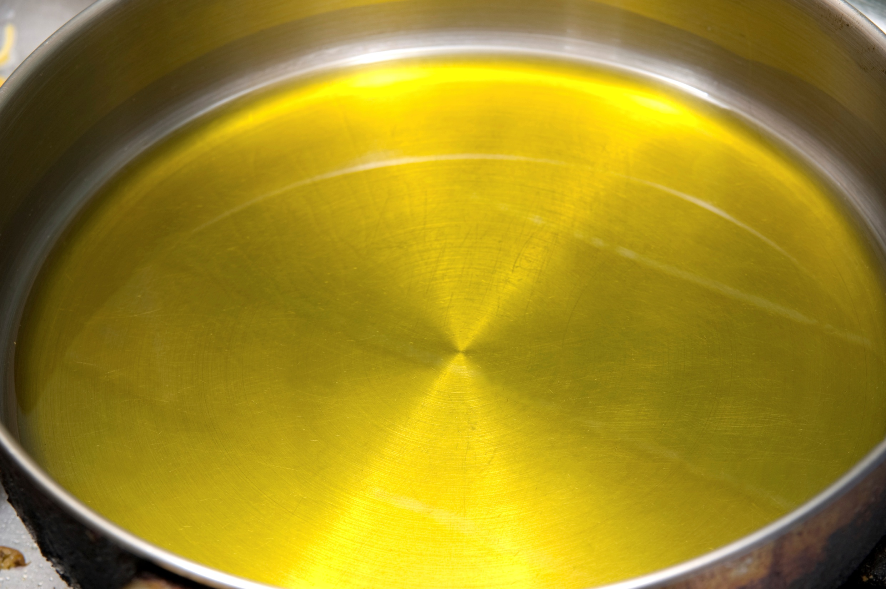
Visit www.Omega-9Oils.com for more information about cooking oil solutions.
OILS

