Slide 1
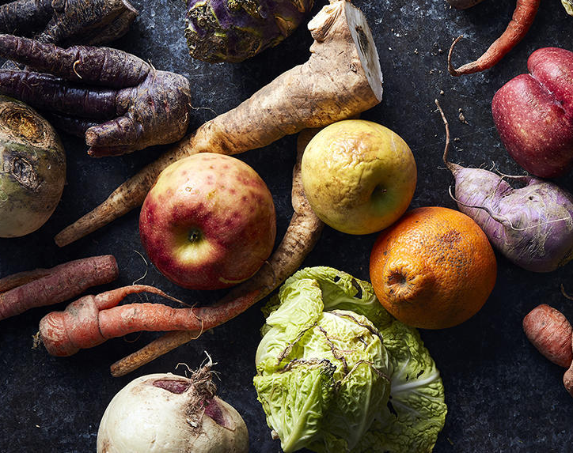
Introducing the Food Donation Improvement Act
Natural Resources Defense Council x Drexel Food Lab
April 2024

Slide 2

Drexel Food Lab is a food product design and culinary innovation lab that applies culinary arts and science to improve the health of people, the planet and economies.
We do this through research and programming that help us:
Understand consumers
Develop new food products
Introduce new products to market
In doing so, we not only develop new food products and menu items with entrepreneurs, industry, non-profit, and government partners, but also develop our flagship "product," graduates across disciplines who are poised to improve the food system.
The Natural Resources Defense Council works to safeguard the earth:
its people, plants and animals, and the natural systems on which all life depends.
Our work includes fighting climate change; eliminating toxic chemicals from the food we eat, the water we drink, and the air we breathe; protecting endangered species and wild places; and advancing urban sustainability and healthy cities.
Notes:
Some of you may not know NRDC so I wanted to quickly introduce our organization.
NRDC is one of the U.S.’s largest environmental groups made up of scientists, lawyers, policy advocates, and a big network of online activists and members
We’ve led the way on many of the nation's key environmental rules – using many different strategies. We help write legislation, we use lawsuits when the government when it’s not protecting our environment like the law requires; we educate policy makers; and we work with companies to improve their environmental practices. And our focus areas range – from protecting our water supply, to addressing food waste.
For the past 6 years, NRDC has developed the nation’s most comprehensive effort to address food waste – and over the past 4 years, our work has taken root in cities through our Food Matters project.

Slide 3


Slide 4
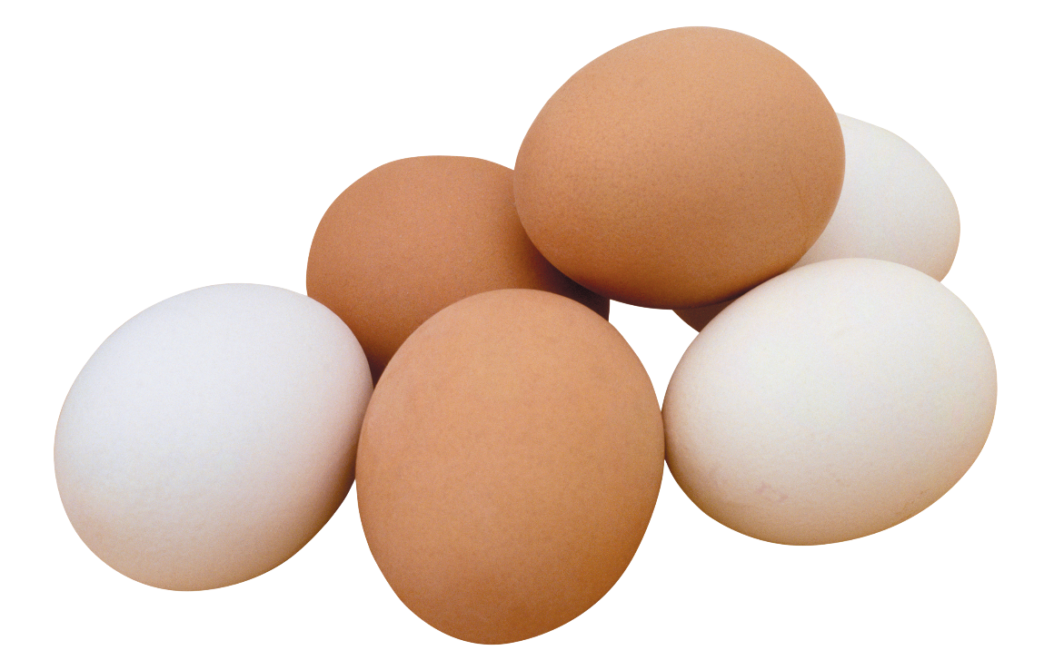
Q: How long of a shower could you take with the amount of water it takes to produce an egg?
45 sec
5 min
22 min
None—producing eggs doesn’t need water like growing vegetables does
Notes:
MADDIE: So, speaking of resources, that leads us to food waste trivia time! Let’s start by understanding the water use associated with food waste.

Slide 5
Q: How long of a shower could you take with the amount of water it takes to produce an egg?
45 sec
5 min
22 min
None—producing eggs doesn’t need water like growing vegetables does
Notes:
NINA
feed, cooling eggs, washing

Slide 6

Q: How many cars worth of GHG emissions does food waste in the US create annually?
860 million
86 million
13 million
3 million
Notes:
Nina: In a drought prone state like California, water use is of tremendous importance to us. But it’s not the only resources used up by food waste. Food Waste is responsible for a lot of carbon pollution. Food waste is responsible for how many passenger vehicles worth of ghg emissions?

Slide 7
Q: How many cars worth of GHG emissions does food waste in the US create annually?
860 million
86 million
13 million
3 million
Notes:
ANDREA

Slide 8
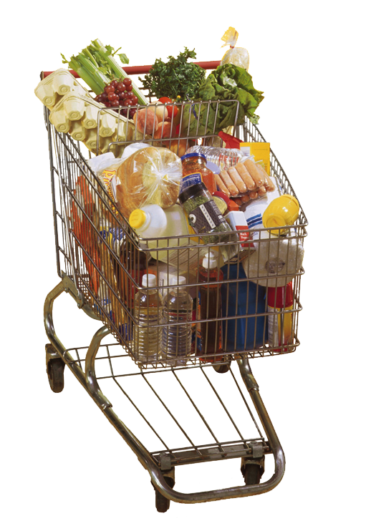
Q: Which of the following sectors is responsible for the most wasted food?
farms
Grocery stores
restaurants
households
Notes:
NINA

Slide 9

Q: Which of the following sectors is responsible for the most wasted food?
farms
Grocery stores
restaurants
households
Notes:
NINA

Slide 10


FOOD WASTE HAS SERIOUS IMPACTS
UP TO 40% OF ALL FOOD IN US GOES UNEATEN, WHICH IS WORTH $444 BILLION PER YEAR
22%
of Freshwater Use
16%
of Cropland
18%
of Fertilizer
24%
of Landfill Content
86m
Cars-worth of GHGs
Notes:
Combined stats from ReFED, EPA, NRDC

Slide 11
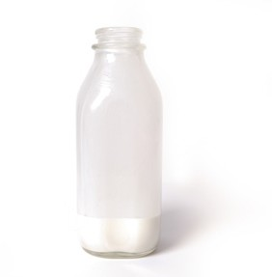
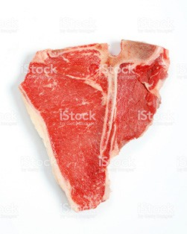
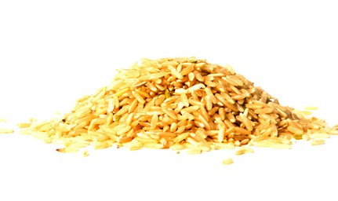
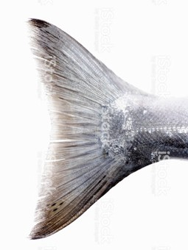
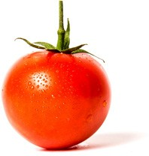
WHAT GETS WASTED?
Milk
20%
Meat
22%
Grains
38%
Seafood
50%
Fruits & Vegetables
52%
Notes:
And this chart gives you some of the highlights of the food that is most commonly wasted. About 20% of milk and meat gets thrown away.
Nearly 40% of grains are thrown out, in the U.S. that’s mostly stale bread, extra bagels, pastries and cakes, and things like that.
With seafood and fruits and vegetables the waste rates are even greater. About 50% of seafood and produce gets tossed.
These losses are huge both for the environment, and for overall nutrition.

Slide 12
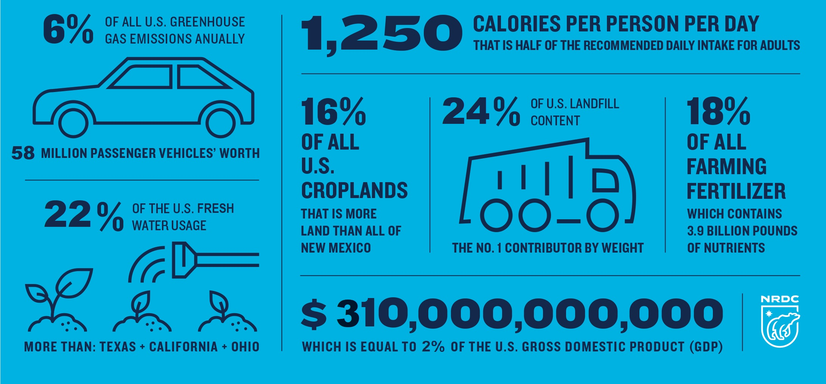
THE U.S. WASTES TONS OF RESOURCES WHEN WE WASTE FOOD
Sources: ReFED What is Food Waste (2023), NRDC Wasted (2017)

Slide 13



If 500,000 tons of food….
is LANDFILLED
it emits 250,731 MTCO²e
Boo
is COMPOSTED
it prevents 326,799 MTCO²e or 69,384 vehicles
Yay!
is PREVENTED
it prevents 2,080,605 MTCO²e or 441,742 vehicles
Source: EPA WARM v16 model
Notes:
Maddie
We are helping cities reduce their food waste by 15% over a 5 year period through a range of catalytic policies and programs.
Our in-depth partnerships with cities like Denver and Baltimore are generating tools and strategies for innovation in additional cities, like Nashville, Atlanta, Pittsburgh, El Paso and many others.
USDN
So, here’s what we’re doing about it. For the past 6 years, we’ve been engaged in the nation’s most comprehensive effort to raise awareness about food waste and quantify the scale of a too-often “invisible” issue.
Because few cities have quantified the amount, sources, or nature of food going to waste at the residential level or in institutional, commercial and industrial settings, we started with three cities – and asked the following questions, among others:
Where is food being wasted?
What type of food is going to waste?
How can it be prevented?
As well as:
How much surplus food can be redirected to people in need?
How can cities tackle the challenge of wasted food most effectively?

Slide 14
WHERE FOOD WASTE HAPPENS
Food Service (Restaurants, Institutions)
Notes:
Talking Points: Food waste happens at every stage of our food system from farm to fork. But if you look at the blue band in this chart – the largest chunk – that is the portion of U.S. food waste that occurs in consumers’ homes, representing about 43% of all food wasted. Although it is not widely recognized, consumers at home are the largest single source of wasted food in the United States. From there, restaurants are the second largest source, at 18% of the total. Grocery stores and distribution generate another 13% and institutional food service (like colleges, hotels and stadiums) generates another 8% of the food waste produced in the U.S. Added together, foodservice businesses represent approximately another 40% of the estimated food waste generated in the US, or about equal to the amount of waste generated by households.

Slide 15
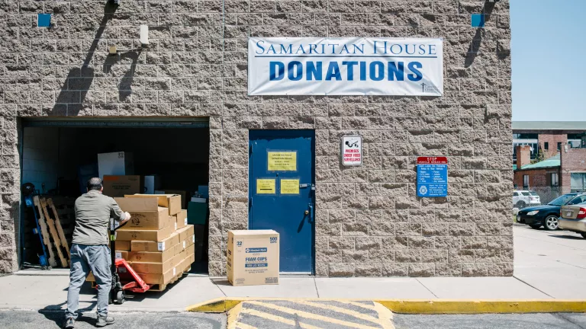
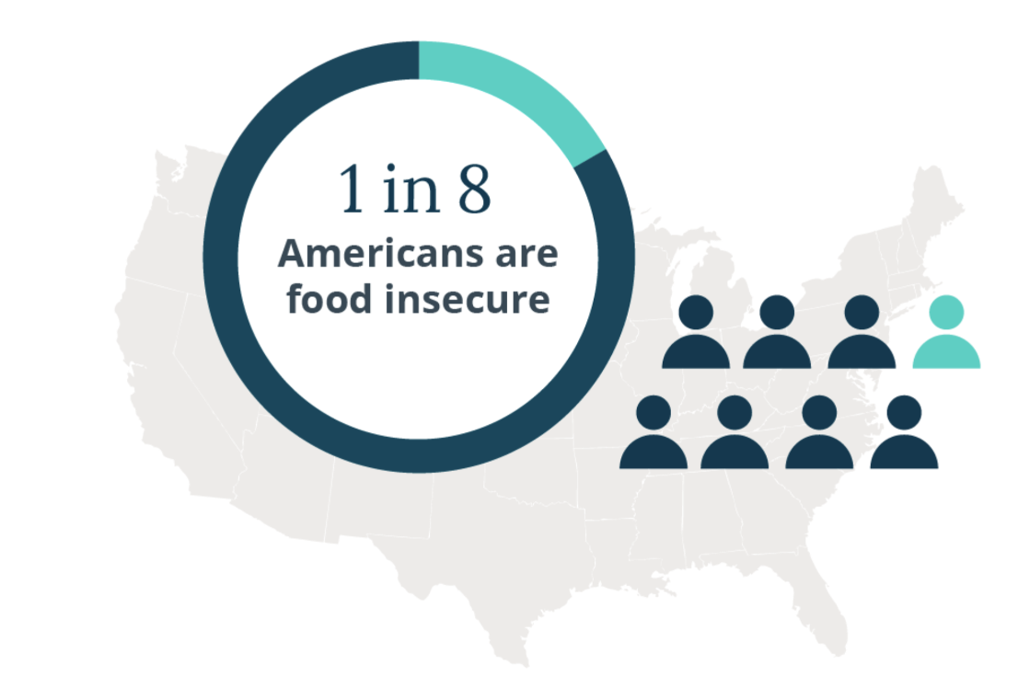
HUNGER IMPACTS OF FOOD WASTE
Halving food waste would provide
4 billion
additional
meals
to the emergency food system.
Source: ReFED; USDA 2022

Slide 16
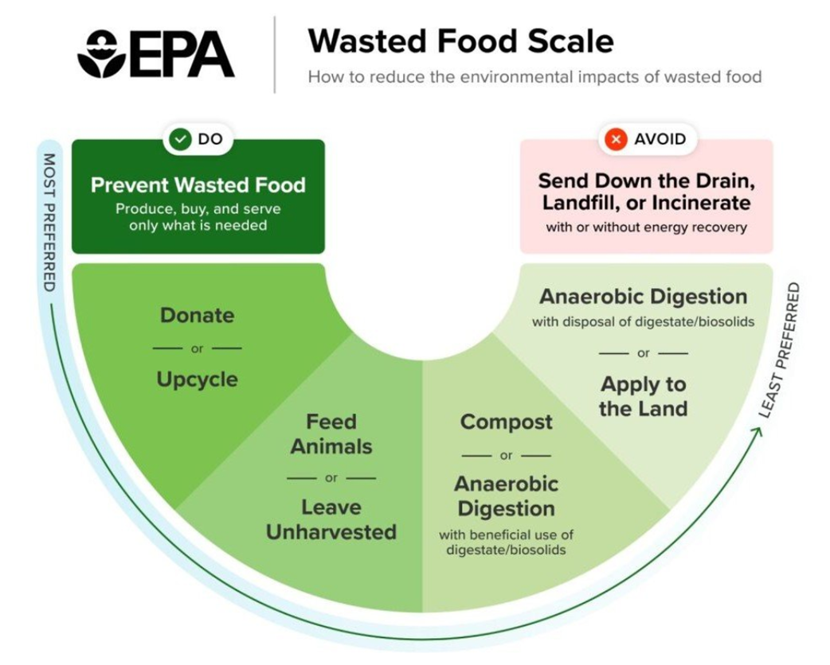
FOCUSING FARTHER LEFT ON THE SCALE BRINGS GREATER
ENVIRONMENTAL, CLIMATE, ECONOMIC, AND SOCIAL BENEFITS
Notes:
The Environmental Protection Agency created a helpful graphic for understanding the hierarchy of addressing food waste. The greatest environmental and social benefits associated with food waste are in preventing food from being wasted in the first place. For businesses, this can mean ensuring that all food purchased is consumed, through strategies such as cooking with all parts of food, practicing better food safety protocols to avoid the need for disposal, and evaluating surpluses in inventory. If, after maximizing food waste prevention, businesses still have surplus food, it’s important to donate suitable food for redistribution to people in need. Finally, any inedible parts or food that cannot be eaten should be recycled through composting, anaerobic digestion, or animal feed.

Slide 17
Passed in 1996, The Bill Emerson Good Samaritan Act provides civil and criminal liability protection for liability that might arise due to harm from donated food or grocery products
The Act covers both donors and intermediaries that distribute food, including:
_{• All individuals}
_{• Government entities}
_{• Schools}
• Businesses (including retailers, restaurants, and wholesalers)
_{• Nonprofit organizations}
• The officers of businesses and nonprofit organizations
• Gleaners (individuals that harvest donated agricultural crops for a nonprofit organization that distributes the food to individuals)
• Farmers, as well as home and community gardeners

Slide 18




Conditions Required to Receive Liability Protections Under the 1996 Emerson Act
1. Qualifying foods and grocery products
2. Direct Donations to Non-Profits *
3. Food Offered for Free *
4. Good Faith

Slide 19


A 2016 survey conducted by the Food Waste Reduction Alliance found that
50% of food manufacturers
and 25% of retailers and wholesalers
still cite liability concerns as a main obstacle to food donation.
According to ReFED, educating potential food donors on liability laws has the potential to divert tons of safe, surplus food from landfills annually.
57,000

Slide 20
Passed in January 2023,
The Food Donation Improvement Act extends the Bill Emerson Act in two ways:
1. Extend liability protection for certain direct donations to individuals
2. Extend liability protection to donations provided at
Good Samaritan Reduced Price

Slide 21
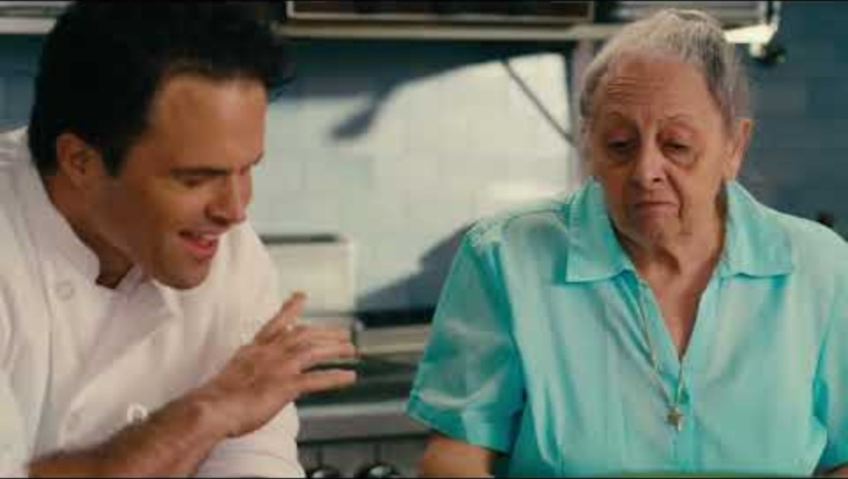
Food is Made to Be Eaten Videos

Slide 22

THANK YOU!
Natural Resources Defense Council:
https://www.nrdc.org/food-waste-reduction
Anya Obrez | aobrez@nrdc.org
Nina Sevilla | nsevilla@nrdc.org
https://www.nrdc.org/food-waste-reduction
Drexel Food Lab @drexelfoodlab
Jonathan Deutsch| jdeutsch@drexel.edu
Drexel.edu/fhm

