Slide 1
Herbs and Spices
Chef Jennifer M. Denlinger, PhD, CCC, CHEP

Slide 2
Herbs
the leaves or certain plants, that are usually grown in temperate climates.
Herbs are the leaves or stems of edible plants used for flavoring foods.
Herbs are extremely perishable
Fresh or dried
Fresh are almost always the best choice
Dried herbs need to be reconstituted in the item they are used in.

Slide 3
Spices
The buds, fruits, flowers, bark, seeds, and roots or plants and trees, many of which grow in tropical climates.
Dried herbs are not spices !
Should be ground fresh!!!!
Spices go stale easily, especially ground spices
Buy whole spices, and grind in small batches to help maintain freshness
Spices can be toasted as well to help reinvigorate their oils

Slide 4
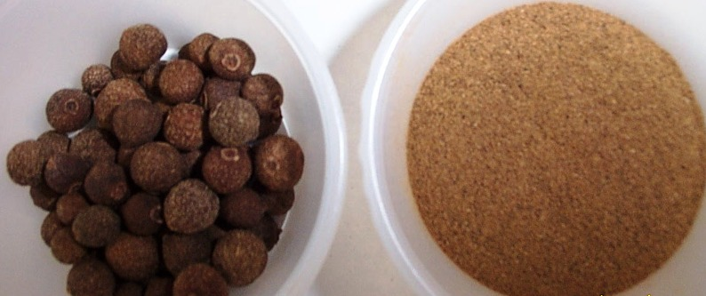
Allspice

Slide 5
Anise Seed

Slide 6
Annatto Seeds (Achiote)

Slide 7
Bay Leaves

Slide 8
Caraway Seeds

Slide 9
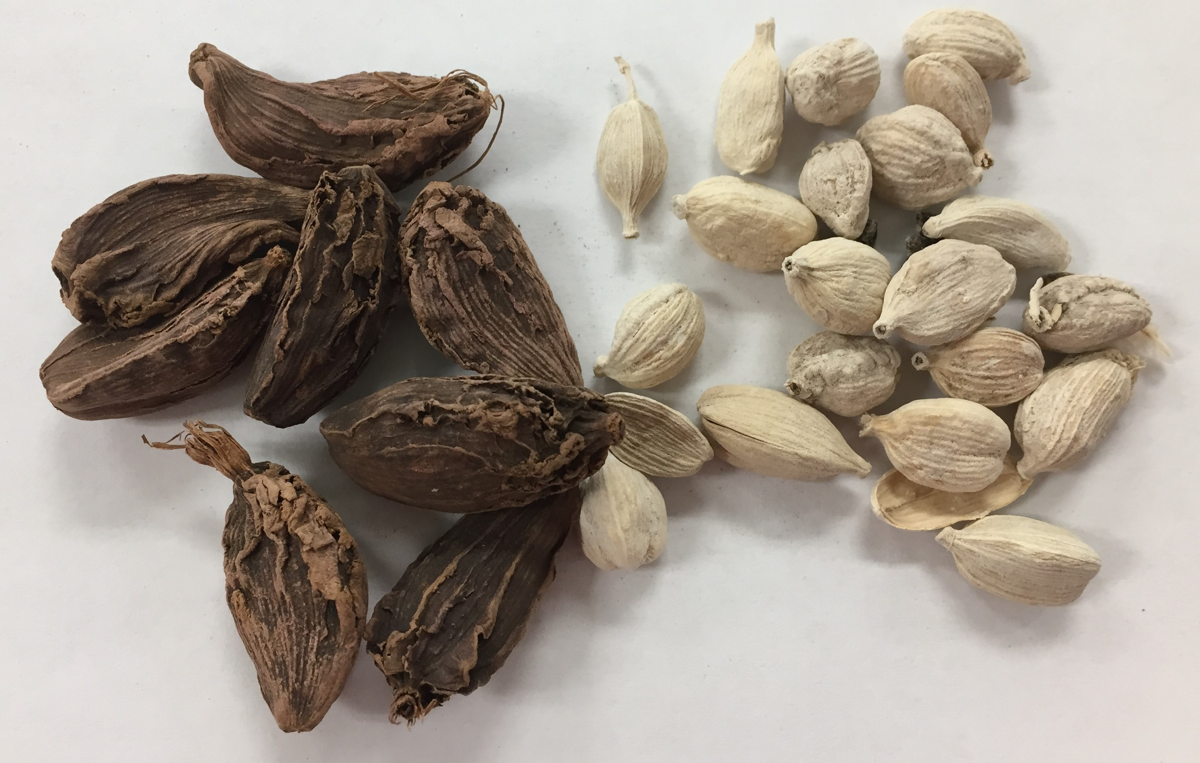
Cardamom
Cardamom Seeds
Green Cardamom
Ground Cardamom
Black Cardamom
White Cardamom

Slide 10
Celery Seeds
Celery Seeds
Celery Salt

Slide 11
Crushed Red Pepper (Chile Flakes) (Red Pepper Flakes)

Slide 12
Chili Powder

Slide 13
Chili Powder vs. Paprika
Chili Powder
Paprika

Slide 14
Cinnamon

Slide 15
Cloves

Slide 16
Coriander

Slide 17
Cumin

Slide 18
Caraway vs. Cumin Seeds
Caraway Seeds
Cumin Seeds

Slide 19
Curry Powder

Slide 20
Curry Powder vs. Turmeric
Curry Powder
Turmeric

Slide 21
Dill Seeds

Slide 22
Dried Onion (Onion Powder)

Slide 23
Fennel Seeds

Slide 24
Fenugreek

Slide 25
Ginger

Slide 26
Juniper Berries

Slide 27
Lavender (dried)

Slide 28
Mace

Slide 29
Mustard
Brown mustard seeds
Yellow mustard seeds
Mustard powder
(ground mustard)

Slide 30
Nutmeg
Whole Nutmeg with Mace
Unpeeled Nutmeg
Whole Nutmeg

Slide 31
Nutmeg vs. Mace

Slide 32
Paprika

Slide 33
Black Pepper
Whole Black Pepper
(Black Peppercorns)
Ground black pepper

Slide 34
Green Peppercorns

Slide 35
Pink Peppercorns

Slide 36
Szechuan Pepper

Slide 37
White Pepper
Whole White Pepper
(White Peppercorns)
Ground White Pepper

Slide 38
Poppyseeds

Slide 39
Saffron

Slide 40
Star Anise

Slide 41
Turmeric

Slide 42
Vanilla Bean (Whole Vanilla)

Slide 43
The ground brown spices
Ground Cloves
Ground Allspice
Ground Nutmeg
Ground Cinnamon

Slide 44
Basil
Green Basil
Opal Basil

Slide 45
Chervil

Slide 46
Chives

Slide 47
Cilantro

Slide 48
Mint (Peppermint)

Slide 49
Oregano

Slide 50
Curley Parsley

Slide 51
Italian Parsley (Flat Leaf Parsley)

Slide 52
Curley Parsley vs. Flat leaf Parsley
Curley Parsley
Flat Leaf Parsley (Italian Parsley)

Slide 53
Rosemary

Slide 54
Sage

Slide 55
Tarragon

Slide 56
Thyme

Slide 57
Some other herbs you may come across……

Slide 58
Lavender (fresh)

Slide 59
Lovage

Slide 60
Marjoram

Slide 61
Epazote

Slide 62
Stevia

Slide 63
Thai Basil

Slide 64
Culantro

Slide 65
Savory

