Slide 1
Elements of Taste & Flavor
Chef Jennifer M. Denlinger, PhD, CCC, CHEP

Slide 2
Definitions
Taste – refers to 5 basic tastes (salt, bitter, sweet, sour, umami)
There are also several other sensations we will look at
Flavor – the sum of all the sensations we get when we have food in our mouth
Sensory Analysis – a scientific discipline that applies principles of experimental design and statistical analysis to the use of human senses (sight, smell, taste, touch, and hearing) for the purposes of evaluating consumer products

Slide 3
What is Taste?
Taste is a complex mixture of flavors and aroma, or smell.
Classically defined as salty, sweet, bitter, sour, hot
Modern palates have evolved past that
Not everyone will experience tastes to the same degree.
Not being able to smell can affect your ability to taste
Tasting is done with taste buds on the tongue and roof of the mouth
Tastes can be broken down into 4 major categories
Push
Pull
Platform
Punctuate
All of these will have several subcategories

Slide 4
Flavor Sensation
3/5 of flavor comes from smell
1/5 of flavor comes from vision and texture
1/5 of flavor comes from taste

Slide 5
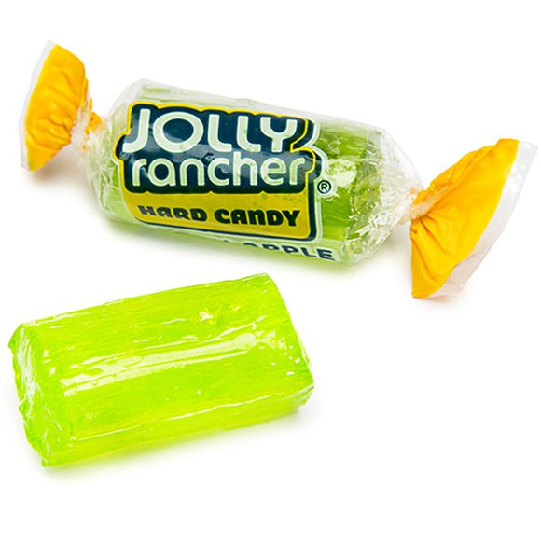
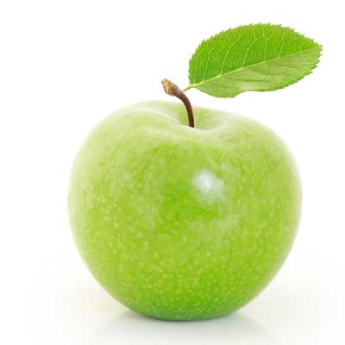
Food is amazingly complex
Sour Apple Jolly Rancher
Granny Smith Apple
Precisely 26 flavor chemicals
At least 2500 flavor chemicals

Slide 6
Why study flavor?
Can you explain the difference between the tastes of cheddar cheese and brie cheese?
Can you explain the difference between a Macintosh apple and a Fuji apple?
You clearly know the difference, but explaining the difference is difficult.

Slide 7
Elements of Taste
sweet
sour
bitter
salty
umami (the “savory” sensation)
pungency
astringency

Slide 8
What is What????
Sweet sugar, honey, corn syrup, fructose
Sour- vinegar, lemon juice, unsweetened yogurt, sauerkraut
Bitter- baking soda, unripe berries, unsweetened chocolate, raw cinnamon
Salty- salt
Umami- “meat”, mushrooms, MSG
Pungent- black pepper, chilies, ginger
Astringent- unripe banana, pomegranate

Slide 10
The Umami Sensation occurs at all points on the tongue, cheek, and roof of mouth

Slide 11
Taste | Primary Actions | Common Sources
SWEET | Builds tissues, calms nerves | Fruit, grains, natural sugars, milk
SOUR | Cleanses tissues, increases absorption of minerals | Sour fruits, yogurt, fermented foods
SALTY | Improves taste to food, lubricates tissues, stimulates digestion | Natural salts, sea vegetables
BITTER | Detoxifies and lightens tissues | Dark leafy greens, herbs and spices
PUNGENT | Stimulates digestion and metabolism | Chili peppers, garlic, herbs and spices
ASTRINGENT | Absorbs water, tightens tissues, dries fats | Legumes, raw fruits and vegetables, herbs

Slide 12
How do you taste?
Tasting most foods involve a combination of all areas on the tongue
Sometimes the absence of one sensation increases the concentration of another
white peaches have lower acidity, so they taste sweeter than yellow peaches
Sweet onions are extremely low in pyruvic acid (which causes the tears when cut), so the natural sweetness in the onion is enhanced
You cannot “erase” one taste sensation by adding more of another.
Sometimes though, they can reduce the sensation

Slide 13
5 basic tastes - SALT
We have evolved to crave salt to ensure we eat enough sodium to sustain life
Salt enables the Maillard reaction
Salt makes savory foods taste more intense (tomatoes)
Salt suppresses sour and bitter
Salt “wakes up” other flavors
Syracuse, New York was a top salt producer in the country for much of the 19th century

Slide 14
5 basic tastes - BITTER
It is thought that bitter is a natural defense mechanism
While we may describe tannin and astringency as bitter, physiologically speaking, it’s a feeling, not a taste
Bitter usually serves to bring taste on the palate to a halt
Salt suppresses bitter tastes
Vanilla does a great job of suppressing bitter as well. Maybe one of the reasons that vanilla lattes are so popular with newbie coffee drinkers?
Bitter greens, Brussel sprouts, coffee, cocoa, citrus pith
IPA – India Pale Ale

Slide 15
5 basic tastes - SWEET
Breast milk is sweet so babies naturally gravitate towards sweet
Sugar can be balanced by acidity (i.e.. peaches, lemonade, Riesling or Sauternes wine)
Sugar is often the first taste to hit the palate, and move towards the background
Rounds out sharp edges of aromatic spices like clove and the tanginess of citrus
Chefs can use various forms of sugar for nuanced flavors (brown sugar, honey, molasses)
Artificial sweeteners all have different sweetness profiles which make it nearly impossible to create a sugar-free drink everyone will accept

Slide 16
5 basic tastes - SOUR
Delicious food is often described as mouthwatering and sour makes our mouth water
A slight increase in acid can make a sauce taste “bright” or “fresh”
Too much sour often means spoilage
Sour is the primary taste of fermentation
Bartenders do an excellent job of balancing sweet & sour
2-1-1 cocktail ratio : 2 parts liquor, 1 part sweet, 1 part sour
Acid can provide balance to savory items (pickle served with a burger)

Slide 17
5 basic tastes - UMAMI
Umami is the “newest” taste and some scientists still don’t think it is a basic taste
Umami is usually described as savory or meaty and makes everything taste a bit fuller or rounder. It adds a depth of flavor.
“The beer goggles of taste”
Worcestershire sauce, soy sauce, fish sauce, ketchup, cheese (esp. parmesan),mushrooms, anchovies, cured meats, kelp, Marmite, etc.
Umami gives food richness and too much can be overwhelming
Acid can tame umami (pickled ginger w/ sushi, deli sandwich w/ pickle)

Slide 19
Aroma Perception
Human olfaction is extremely sensitive (1 part per 50 billion)
Sense of smell is better in the morning
Elderly are less sensitive than young adults
Females more sensitive than males
Smokers less sensitive than non-smokers
Remember there are only 5 basic tastes; the details are in the aroma

Slide 20
Retronasal Olfaction

Slide 21
Other Taste Factors - Temperature (mouthfeel)
Hot foods often have stronger flavor as the molecules in the food are zipping around faster
Dissolve faster
Find your taste buds faster

Slide 22
Enjoying a cup of coffee
The sound of the beans grinding
The smell
The sound of it percolating
The warmth of the cup
The pleasant bitterness
The anticipation of the jolt the caffeine gives
Do you think the experience contributes to the taste of the coffee?

Slide 23
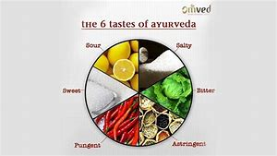
Ayurveda
A traditional approach to food practiced in India for thousands of years.
Ayurveda=science of life
Ayu=life
Veda=knowledge
5 elements
3 constitutional types (doshas)
6 tastes

Slide 24
Ayurveda
For centuries studied by scientists and philosophers
Central to this is that our bodies, mood and health are impacted by our diet
To be healthy and happy must seek harmony and balance in diet
In India practitioners of Ayurveda receive government recognized formal training, similar to medical school on USA
Space
Air
Earth
Fire
Water
These elements make up everything in the universe including the human body
These elements come together to create the doshas

Slide 25
Balancing the Doshas Through Taste
 | Most Balancing | Most Aggravating
Vata (air & space) | Sweet, Sour, Salty | Bitter, Pungent, Astringent
Pitta (fire & water) | Sweet, Bitter, Astringent | Sour, Salty, Pungent
Kapha (earth & water) | Pungent, Bitter, Astringent | Sweet, Sour, Salty

Slide 27
Now what?

Slide 28
Tastes that push
Salty
Sweet
Picante
They heighten all the other tastes in a recipe, often used as a foundation when layering flavors
All can be combined in a recipe “balancing a sauce/ dish”

Slide 29
Tastes that pull
Tangy
Vinted
Bulby
Floral Herbal
Spiced aromatic
Funky
“Pull” tastes seek out underlying flavors and highlights them
Some ingredients broadly pull, while some enhance through aroma

Slide 30
Tastes that punctuate
Sharp
Bitter
Serves as a signal to stop one taste and start another
Texture, such as crispness or smoothness helps one make sense of complex taste messages
Separate or unite the layers of taste in a recipe
Fats and oil help to spread flavor around the palate and launch aroma to the nose

Slide 31
Other Taste Factors - TEXTURE (mouthfeel)
We often think of texture as primarily crunchy or crispy
Ben and Jerry’s
Smoothness
Gelatin from demi-glace
Tripe
Carbonation

Slide 32
Other Taste Factors - ASTRINGENCY (mouthfeel)
Our mouths “pucker” to register astringency
Red wine, strong tea
Walnuts
Cranberries
Campari
Sorbet used as an intermezzo

Slide 33
Other Taste Factors - HOT Receptors vs. COLD Receptors
Not a taste, but a feeling
Hot – pepper, chiles
Cold – mint, menthol

Slide 34
Other taste factors- PIQUANT
There are nerve endings on the tongue that taste peppery heat, except they are pain receptors
Picante is not recognized by science as a taste

Slide 35
Other taste factors- SHARP
Tastes that punctuate
Similar to bitter, but with some picante heat in the aroma

Slide 36
Other taste factors- TANGY
Taste that pulls
Often referred to as sour
Seems to brighten flavors making them more distinct
Partners well with most other flavors except bitter

Slide 37
Other taste factors- VINTED
Tastes that pull
Wine as a food ingredient has 2 pulling characteristics
The bitterness of wine helps cut through other tastes and to clean the palate
The fruitiness of wine also pulls forward sweetness, which compliments salt
Not commonly found in most cuisines from Asia, North Africa, and the Middle East

Slide 38
Other taste factors- BULBY
Taste that pulls
Usually from members of the onion family
Their aroma tends to fill the nose
Raw: tends to be rather sharp
Cooked: the sugar caramelizes and the sharpness becomes sweet and slightly nutty
Don’t generally pair well with sweet things like fruit

Slide 39
Other taste factors- FLORAL /HERBAL
Tastes that pull
Often used to pull up and focus specific tastes
Usually refers to herbs
Herbs with a licorice taste will pull the sweet side of a recipe
Tarragon
Basil
Some herbs will accent the saltiness, meatiness, and fishiness as well as define garden tastes
Rosemary
Thyme
Oregano
Marjoram
Some will accent the element in the fruit that differentiates it from pure sugar
Lemon zest
Ginger

Slide 40
Other taste factors- SPICED AROMATIC
Usually refers to spices
When tasted by themselves, they tend to be bitter
Generally used for the aroma that is produced with cooked

Slide 41
Other taste factors- FUNKY
Tastes that pull
Have an organic, overripe smell
The smell and taste of aged, highly organic ingredients stimulates the palate and pulls up strong flavors
Cabbages
Truffles
Aged meats
Pungent cheeses

Slide 42
Other Taste platforms
Vegetables, meat, poultry and fish are the foundations upon which we build recipes
Try not to think of them as main ingredients (although they are), but as the main platforms upon which other tastes can stand and interact.
Garden
Meaty
Oceanic
Starchy

Slide 43
Taste Platform- GARDEN
All vegetables have some common element
Watery aspect
Pleasing crunch when eaten raw or lightly cooked
Some have sugar that sweetens and smooths
This can caramelize and intensify flavors

Slide 44
Taste Platform- MEATY
Meat is hard to overpower with other flavors
Can support or even improve spices, herbs, wine, vinegar, breading, brining
The 2 strongest impressions of meats
Texture
Aroma

Slide 45
Taste Platform- OCEANIC
There are 3 components to the taste of fish and seafood
Aroma
Taste on the palate
Texture
(i.e.- shellfish have a buttery component, and fresh water fish have a milder taste than saltwater fish)

Slide 46
Taste Platform- STARCHY
Starches tend to marry well with strong flavors, diffusing and extending them
The starches’ primary function in the mouth is texture
Coats the tongue, calming down strong flavors and cleans off the palate

Slide 47
Seasoning vs. Flavoring
Flavoring is meant to add a new flavor to the food, thus changing or modifying the original flavor
Seasoning is meant to enhance the natural flavor of the food without significantly changing it’s flavor
Most items need to be added at the beginning of the cooking process so their flavors can be released and blended in
Too much cooking could cause flavors to be lost
Few items can be added at the end of cooking
Fresh herbs
Liqueurs/ wines
Mustard
Worcestershire sauce
Tabasco
Add at the end of the cooking process to round out the flavors
Add at the beginning of the cooking process to have the seasoning absorbed or blended in
Reduction may concentrate the seasoning

Slide 48
Overall
Is taste alone all you can go by?

Slide 49
Reflect
Describe factors that can affect our perception of flavors. Discuss the ways this relates to prepare certain foods.
What is a flavoring? Does every kitchen stock the same flavoring ingredients? Explain your answer.
What is sensory analysis?
Identify the seven elements of taste.

